Slide 1

Extended ER Project: Amazon
Group 3
Snehal Dhatrak, Swarangi Patil, Cheyenne Manning, Pedro Monroy-Polanco, Rohini Mallikarjunaih
MIS – 631 A
Professor Morabito
May , 2025

Slide 2
Table of Contents
Context and Project Goal
Project Scope
Business Rules
High-Level ER
Extended ER
Information Modeling
Contracts
Placing a Purchase Order
Payment of an Invoice
Return Policy

Slide 3
Context and Project Goal
Amazon is a global leader in online retail, offering a vast marketplace for both B2C and B2B customers. The goal of this project is to design an extended ER (Entity-Relationship) model that captures the core business processes of Amazon’s retail operations, focusing on procurement, order management, vendor compliance, and product lifecycle management. The system must ensure compliance with regulatory standards, supplier management, and efficient handling of purchase orders and payments
Project Scope
The scope encompasses:
Managing and monitoring products throughout their lifecycle (from procurement to decommissioning or delisting)
Tracking purchase and sales history for each product
Monitoring vendor performance and compliance with Amazon’s Supply Chain Standards2
Ensuring only approved vendors can supply products
Handling contracts, purchase orders, and payment processes
Supporting both individual and business customers (B2C and B2B)

Slide 4
Business Rules
Only approved suppliers that comply with Amazon’s Supply Chain Standards can sell products.
All products must have a unique Product ID.
Purchase orders can only be placed with approved suppliers.
Vendors must undergo regular audits and maintain compliance.
Customers (individual or business) can place orders for available products.
Each purchase order and invoice must be tracked and linked to the relevant product and supplier.
Products can be decommissioned or removed from the catalog if they fail to meet quality or compliance standards.
Dangerous goods (e.g., batteries) require special handling and labeling.
30-day default return window for all products.

Slide 5
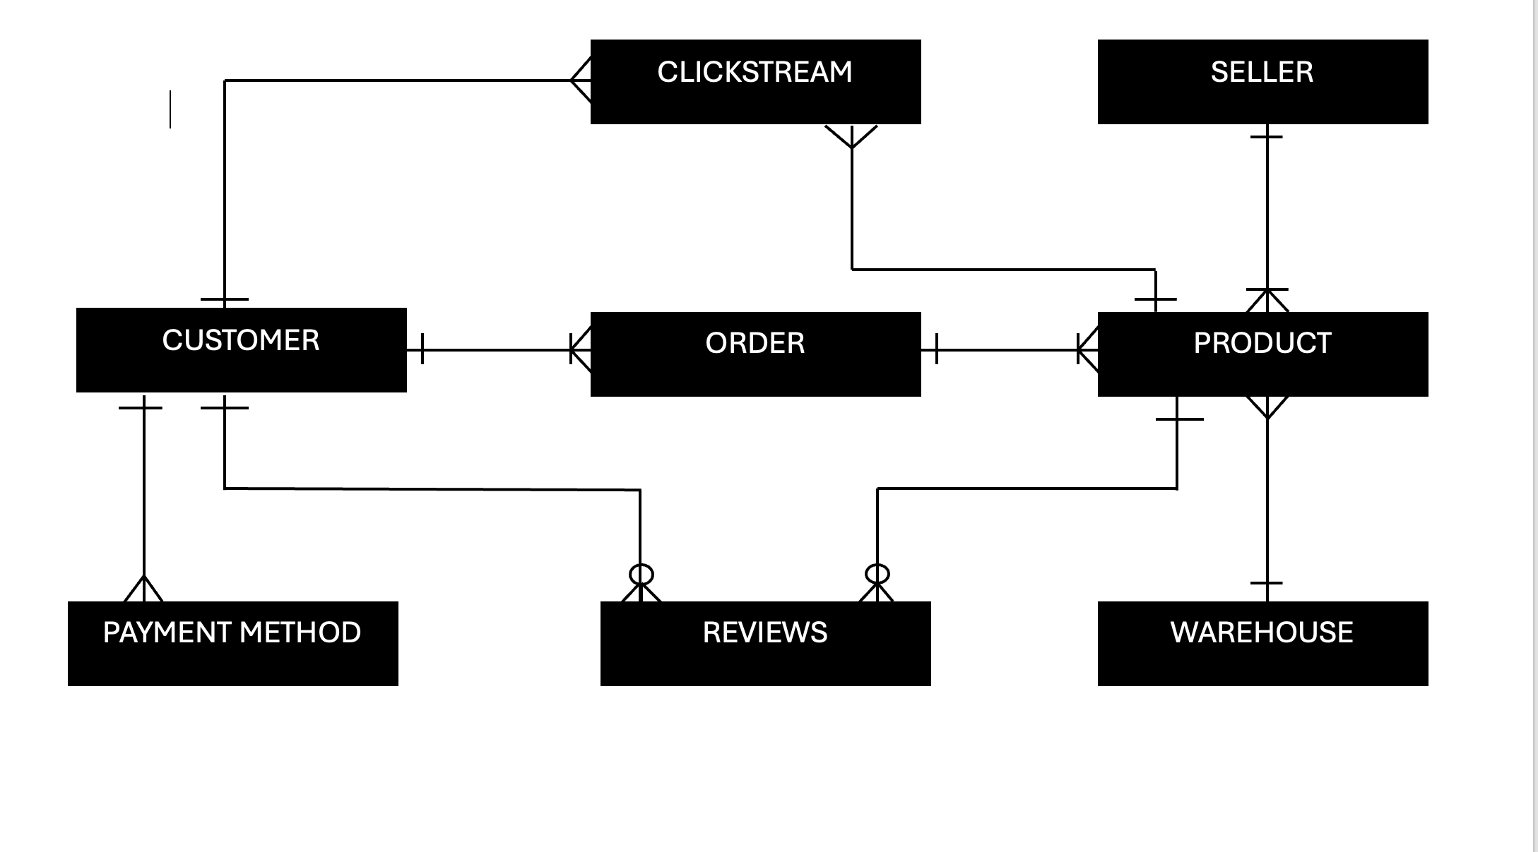
High Level Data Model

Slide 6
Entities involved:
Customer
Address
Product
Orders
Seller
OrderItem
Transaction
ProductListing
RecommendationLog
SearchHistory
Shipment
PaymentMethod
Review
Clickstream
Category
Inventory
Warehouse
Refund
SellerFeedback

Slide 7
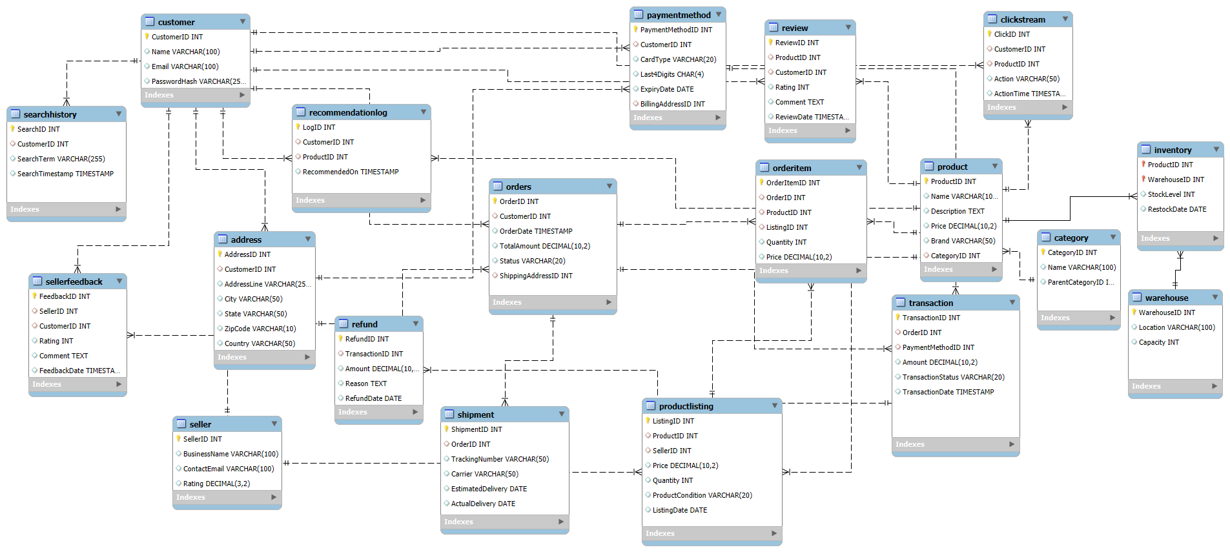
Detailed ER Diagram

Slide 8
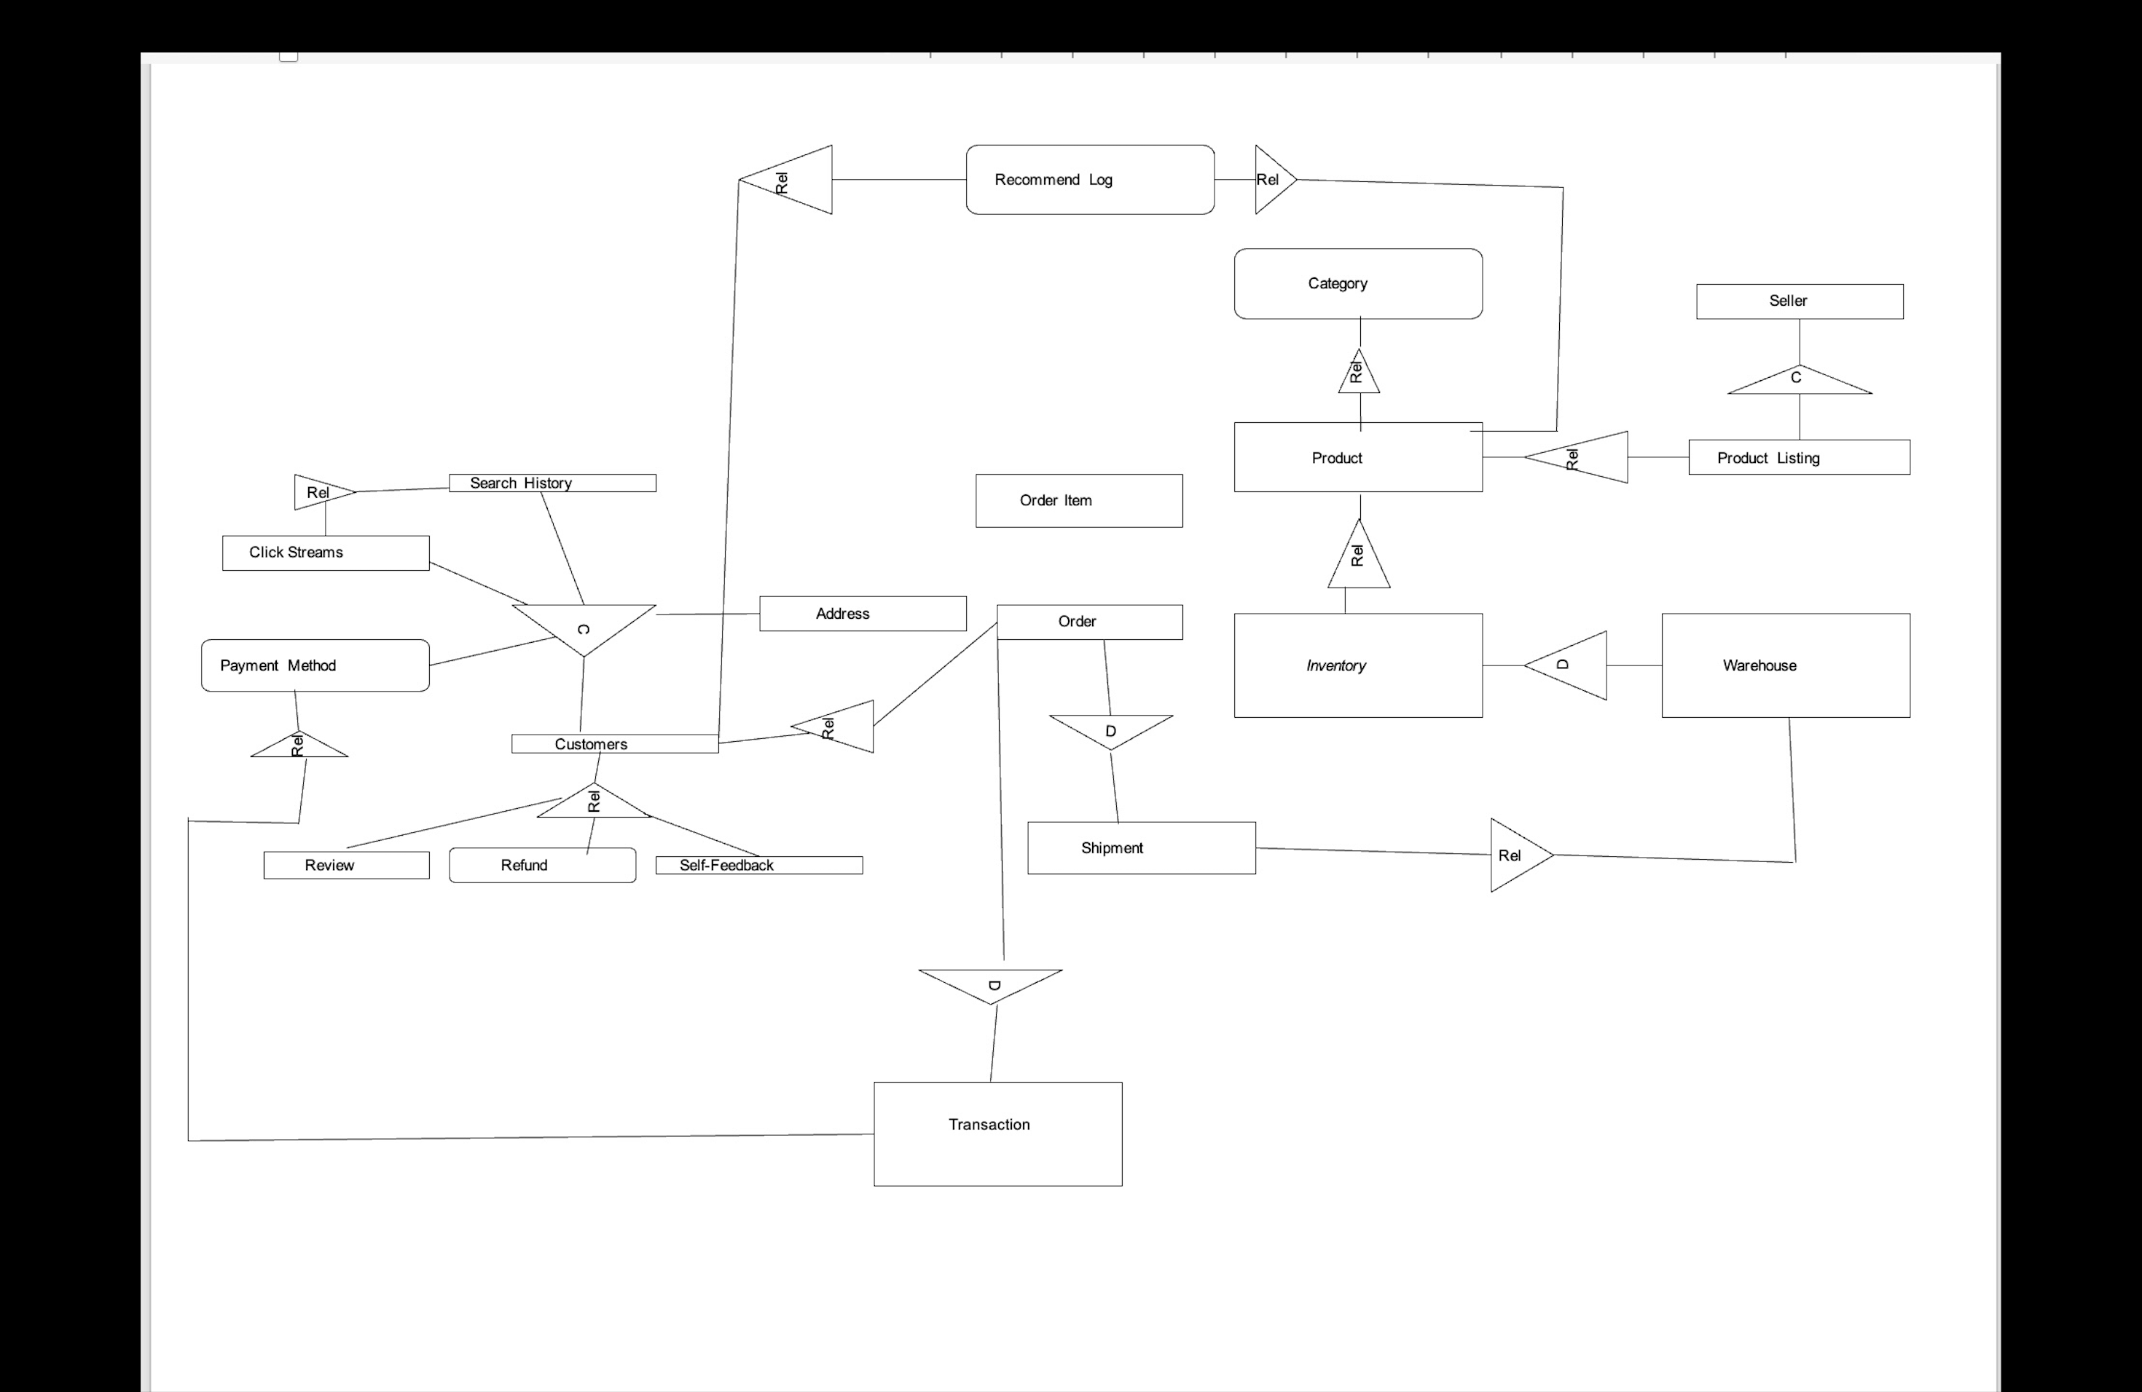
Information Modelling Diagram

Slide 9
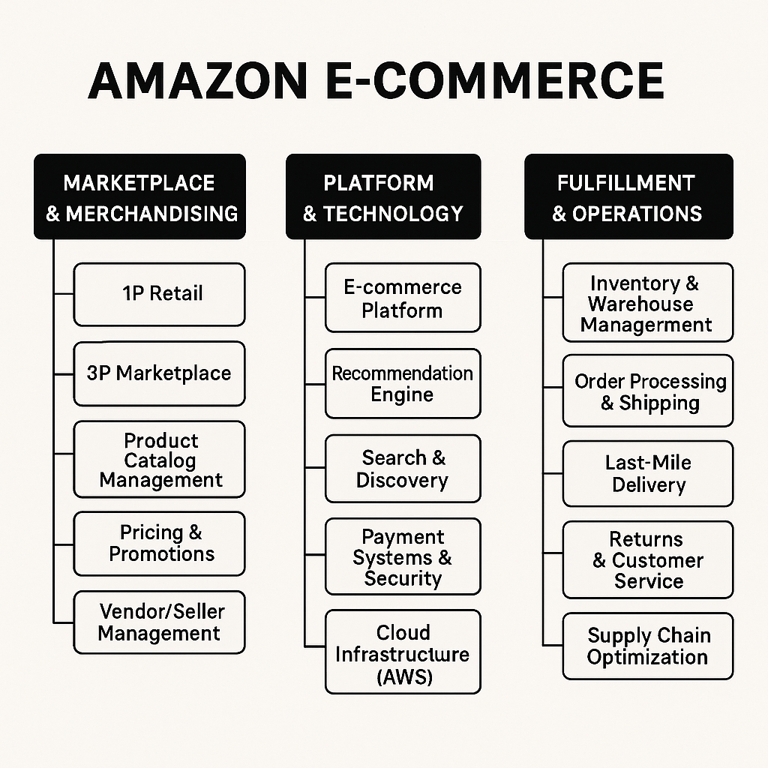
Amazon E- Commerce can be divided into three functional units:

Slide 10
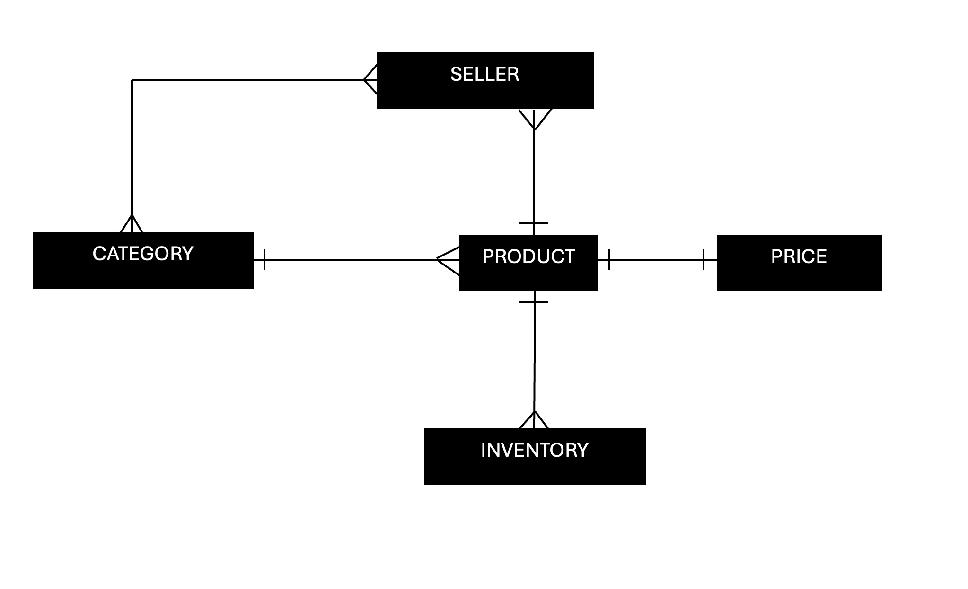
Marketplace and Merchandising High-Level Data Model

Slide 11
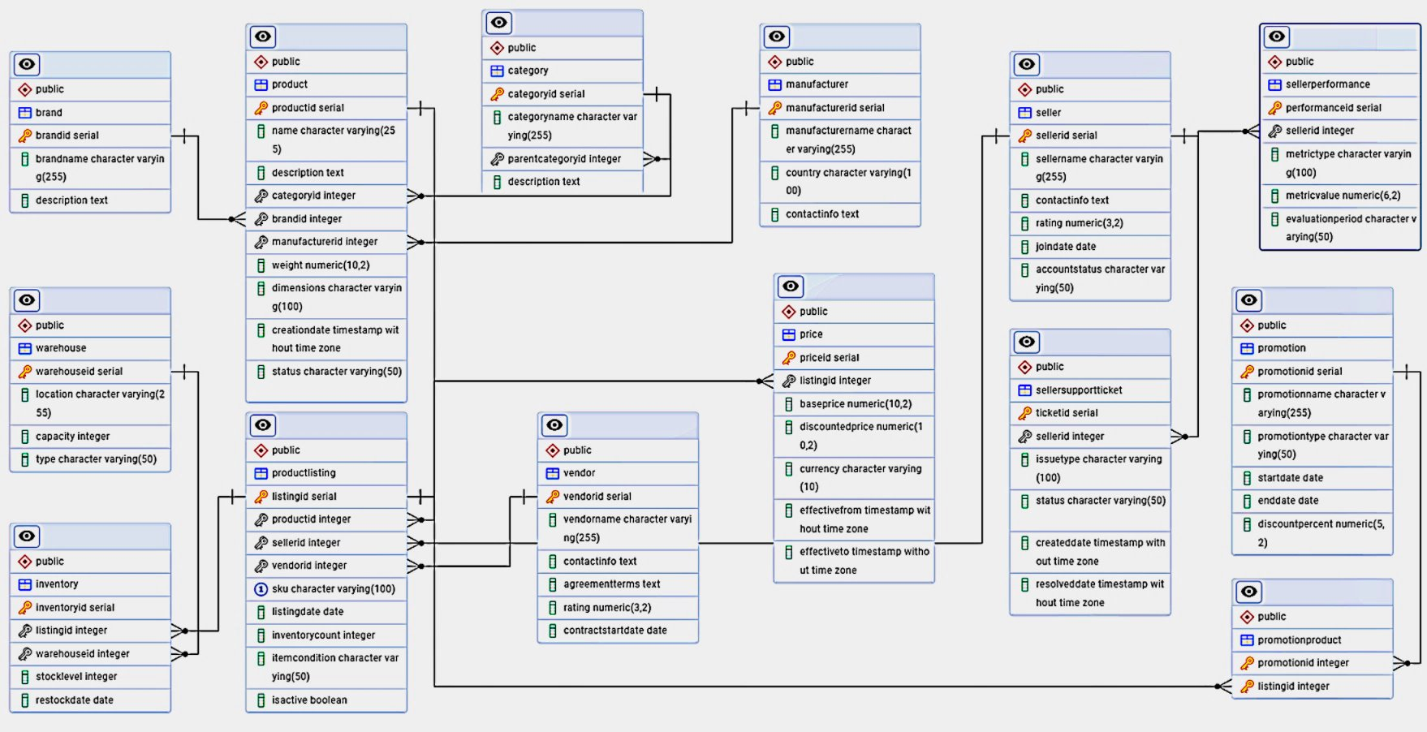
Marketplace and Merchandising ER Diagram

Slide 12
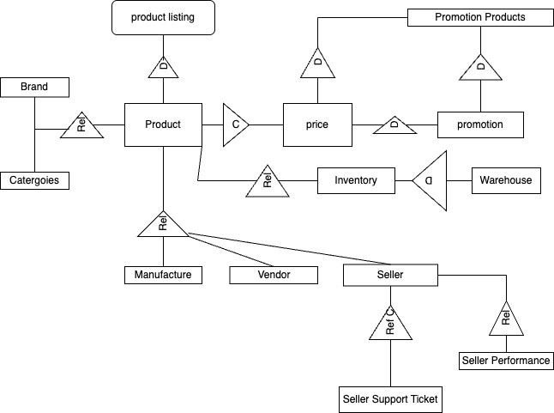
Marketplace and Merchandising Information Modelling Diagram

Slide 13
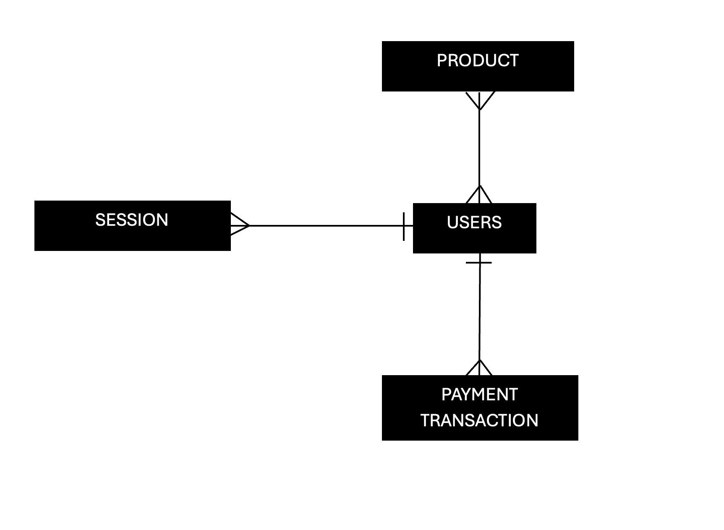
Platform and Technology High Level Data Model

Slide 14
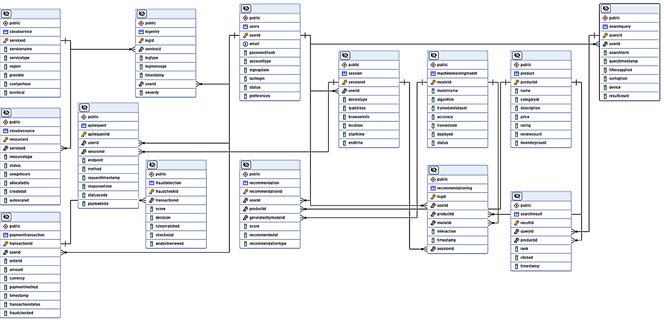
Platform and Technology ER Diagram

Slide 15
Platform and Technology Information Modelling Diagram
Ref
Payment Transaction
D
Fraud Detection
Ref
Search Result
Rel
Search Query
Ref
User
c
Session
Ref​
D
Product
Ref
Recommendation
Ref
​
C
Machine Learning model
Ref​
Recommendation Log
Rel
API Request
Ref​
Log entry
Ref​
Cloud Service
C
Close Resource

Slide 16
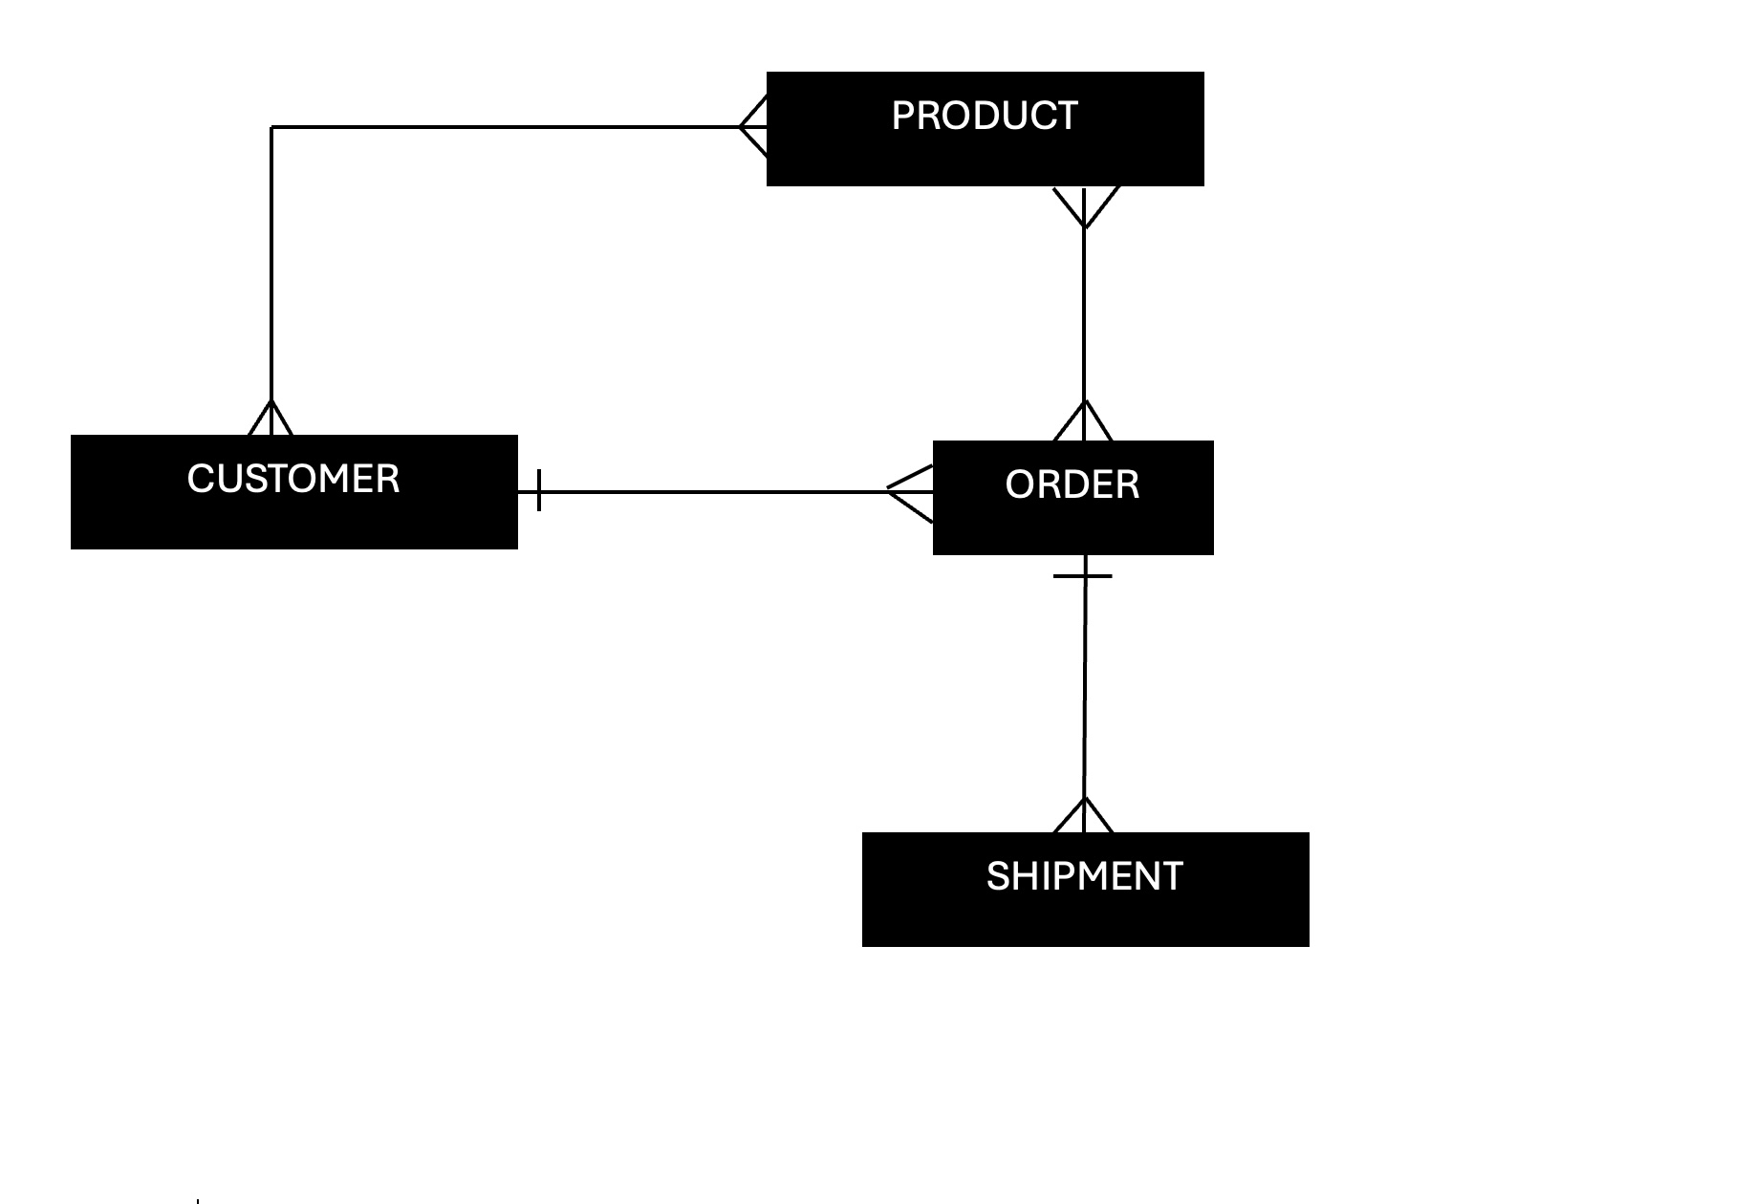
Fulfillment and Operations High Data Model

Slide 17
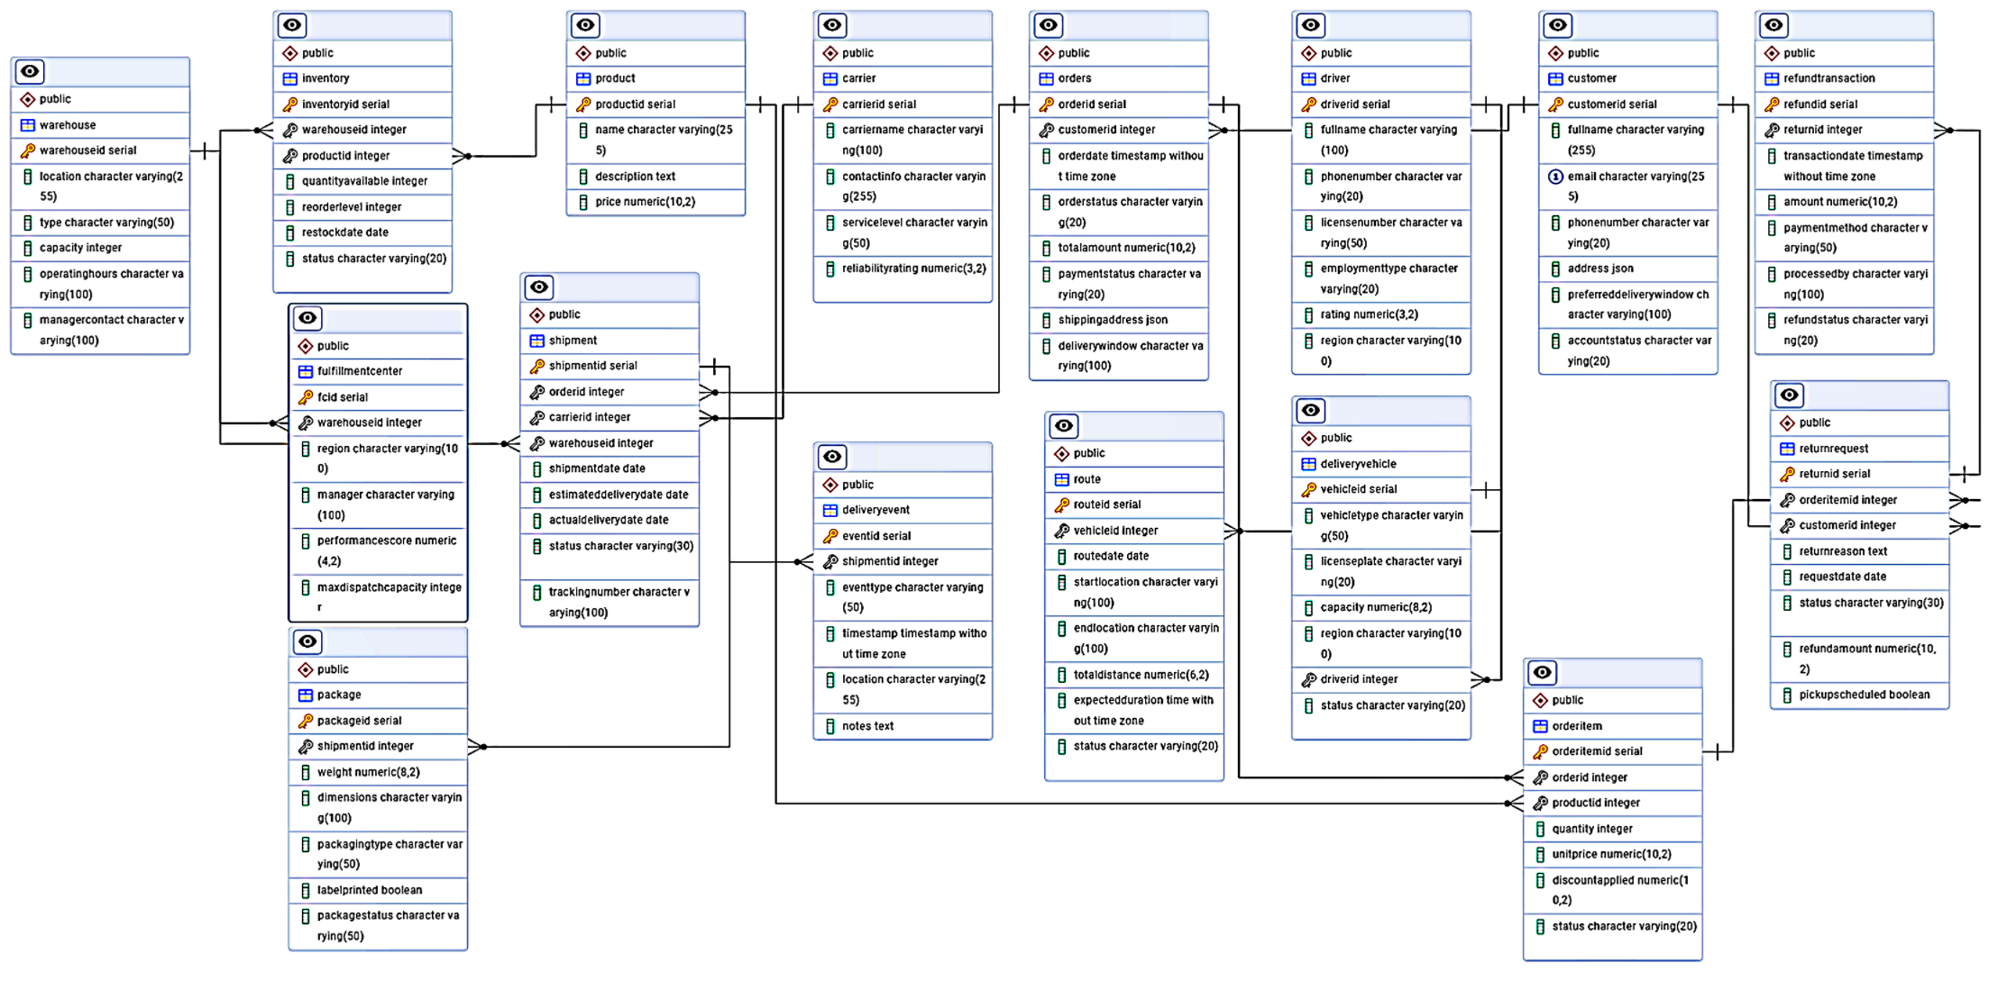
Fulfillment and Operations ER Diagram

Slide 18
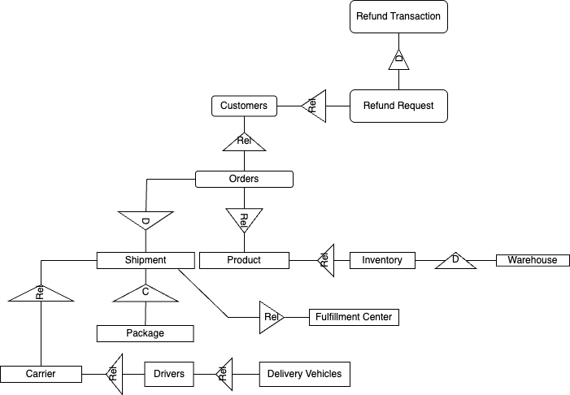
Fulfillment and Operations Information Modelling Diagram

Slide 19
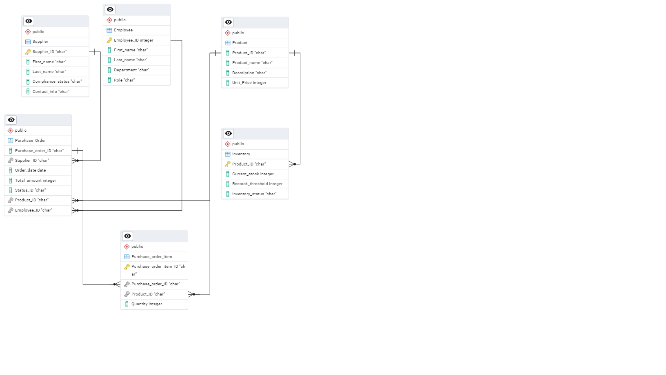
Contracts: Placing a Purchase Order

Slide 20
Invariant:
The purchase order must reference an existing supplier and product.
No duplicate active purchase order for the same supplier and product combination.
Pre-condition:
Supplier is approved and active in the system.
Products to be ordered are listed and need to be ordered (inventory is falling below desired threshold).
Purchase department authorization is granted for procurement.
Budget is available for the purchase.
Post-condition:
A new purchase order is created with corresponding purchase order number, supplier, product list, quantities, and expected delivery date.
A notification is sent to supplier.
Inventory item status is changed to "restock in progress".
Trigger:
Restock request is sent in.
Inventory is low.

Slide 21
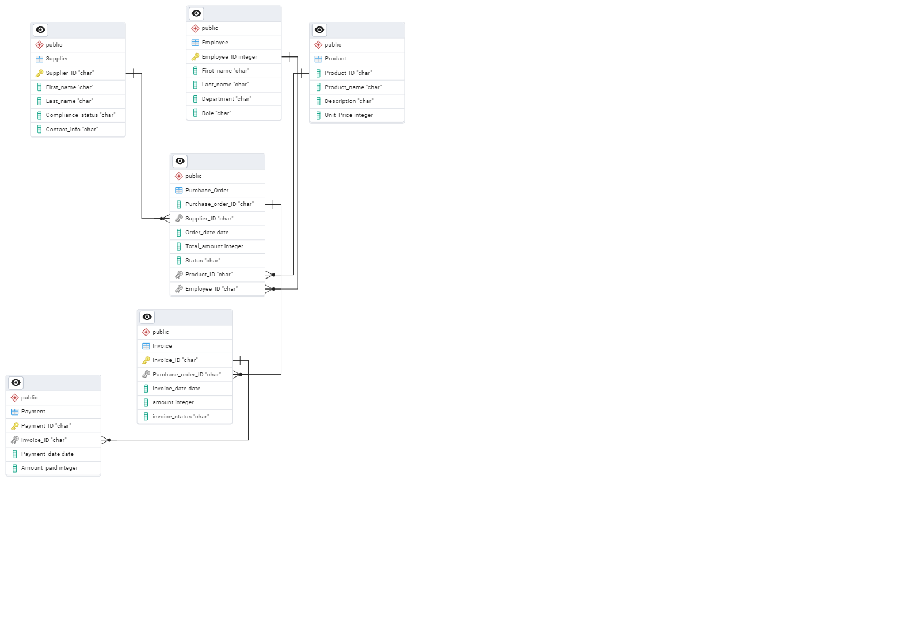
Contract: Payment of an Invoice

Slide 22
Invariant:
The invoice will only paid when it has been matched to a verified purchase order.
Purchase order is verified as fully or partially received.
Goods have passed quality control inspections.
Pre-condition:
Invoice is received from the supplier.
Goods have been delivered and were verified.
Inventory is updated to reflect goods are received and have been inspected and passed standards.
Payment terms have been validated.
Post-condition:
Payment transaction is created and is linked to the invoice and supplier.
Invoice status changed from pending to "paid".
Financial records are updated to reflect changes.
Trigger:
Approved invoice is due for payment.

Slide 23
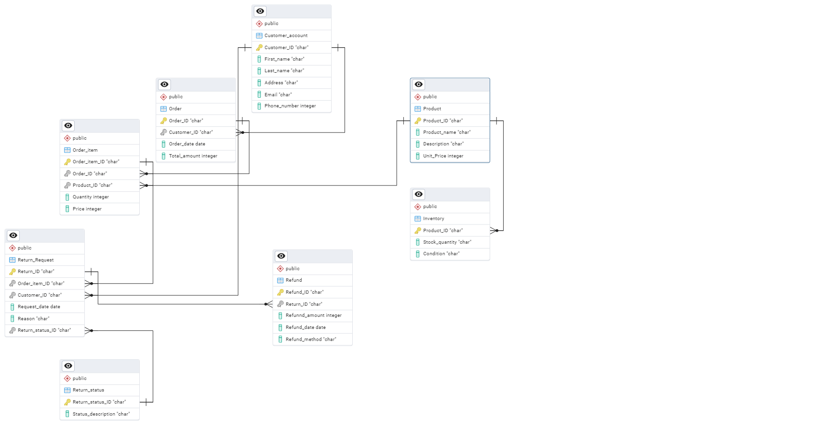
Contract: Return Policy

Slide 24
Invariant:
Every return must be linked to an existing customer and an original purchase order.
Return must happen within the allotted time frame (30 days from delivery).
Pre-condition:
The customer has received the product.
The customer initiates a return request.
The product is within the return window.
Product must be eligible for return.
Post-condition:
A return order is created, and it is linked to an original order and customer.
A refund is initiated, or a refund is shipped.
Inventory is updated based on condition of returned item.
Return status is updated.
Trigger:
A customer submits a return request.

Slide 25
Group 3

